Slide 1


Chitkara University
Online Medical Management System.
Presented by
Guided by
Abhay Gupta (1911985068)
Mr.Mukesh(MYANATOMY)
Mr.Mananjay(MYANATOMY)
Submitted for the partial fulfillment
of
Integrated B.E-M.E
in
Computer Science And Engineering.
Department Of Computer Science And Engineering.
May - 2022

Slide 2
Content
Abstract
Introduction
Theory and fundamentals
Entities Created
Level 0 Data Flow Diagram
Level 1 Data Flow Diagram
Tools and technologies
Conclusion
Future scope
References
Online Medical Management System.
May - 2022
2

Slide 3
1. Abstract
This online medical management serves the purpose of viewing different departments in the hospital,viewing opd schedule corresponding to that particular department with consultant names,booking of appointment for different opd schedules etc.The goal of this project is to serve the public with accurate information regarding all the departments and their corresponding schedules on a particular day.Some of the technologies used in this project are Spring Boot,JPA,Hibernate,Spring Security,Mysql and Angular.
Online Medical Management System.
May - 2022
3

Slide 4
2. Introduction
This Online Medical Management System is used in healthcare system.The main use of medical management system is to provide all the data regarding medical infrastructure of the hospital.
This Project consists of frontend in angular and backend in spring boot.
To switch between different pages I have used routing in angular to provide different paths.
For connectivity between database and spring boot backend I have used Hibernate through JPA.
Hibernate is a ORM tool which is used to create entries of tables in database through some sort of Annotations.
Online Medical Management System.
May - 2022
4

Slide 5
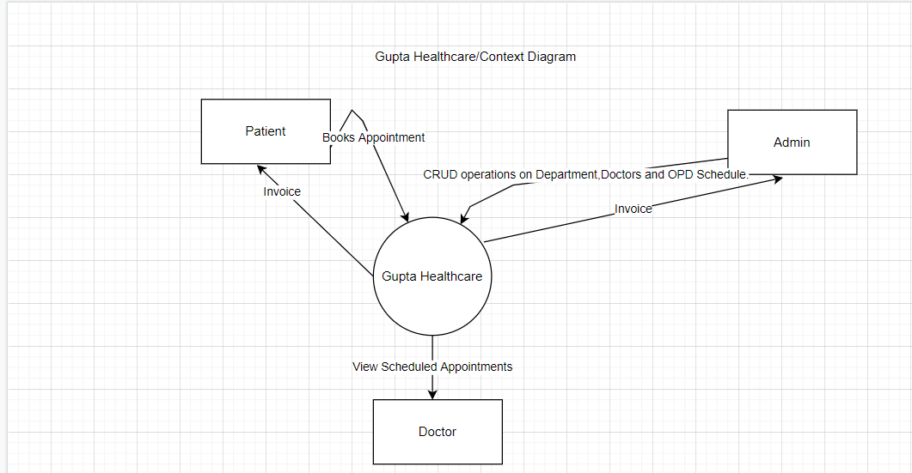
Level 0 Data Flow Diagram(Context Diagram).
Level 0 DFD For Gupta healthcare.
Online Medical Management System.
May - 2022
5

Slide 6
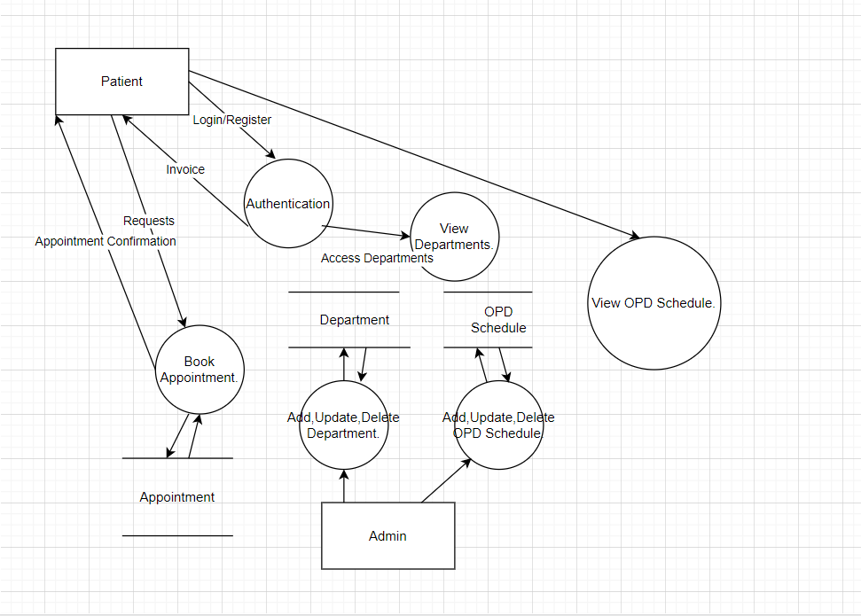
Level 1 Data Flow Diagram(Context Diagram).
Level 1 DFD For Gupta healthcare.
Online Medical Management System.
May - 2022
6

Slide 7
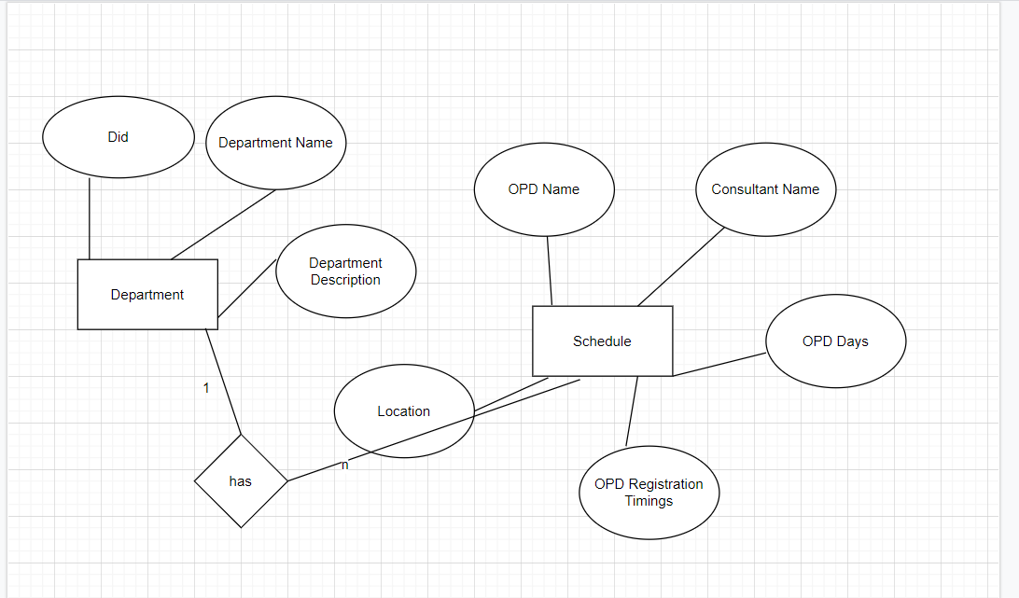
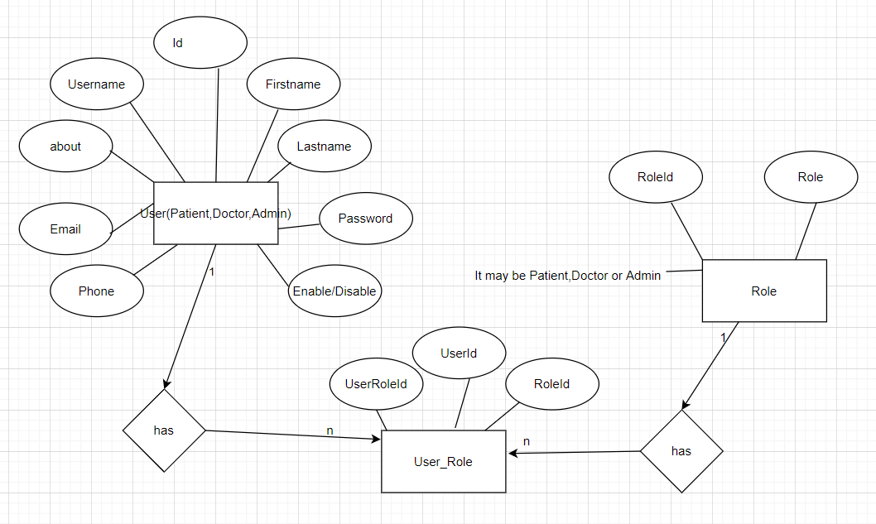
3. Theory and fundamentals(ER Diagrams)
There are two dashboards in this project one is user dashboard and one is admin dashboard.The role of admin dashboard is to add,update and delete departments,opd schedule etc.The ER Diagram of the project is s follows:
Online Medical Management System.
May - 2022
7

Slide 8
3. Theory and fundamentals(DFD Diagrams)
A Data Flow Diagram (DFD) is a traditional visual representation of the information flows within a system. A neat and clear DFD can depict the right amount of the system requirement graphically. It can be manual, automated, or a combination of both.
It shows how data enters and leaves the system, what changes the information, and where data is stored.
Online Medical Management System.
May - 2022
8

Slide 9
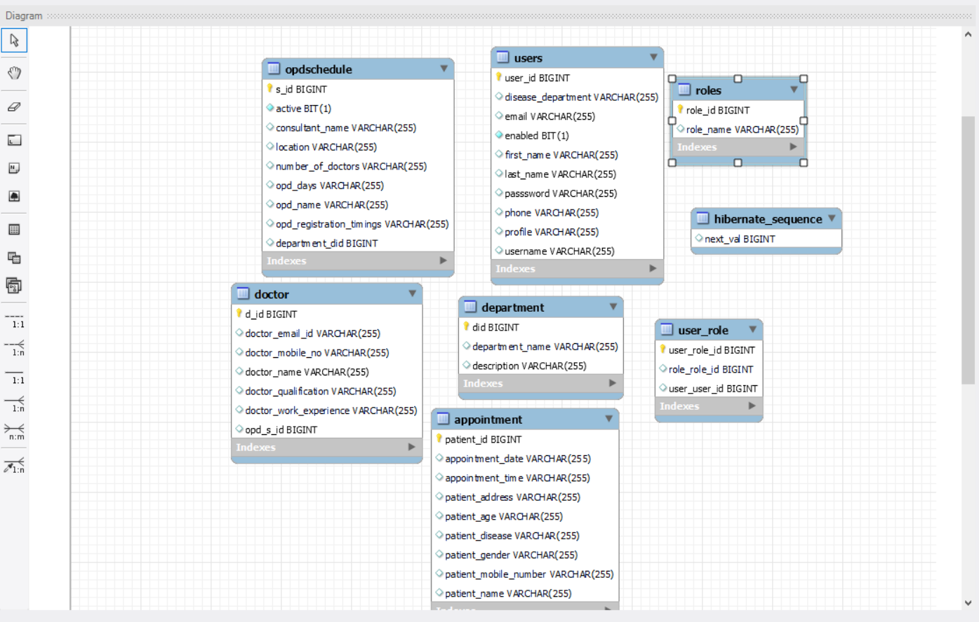
4.Entities Created.
These are the entities which are created in the database.
Online Medical Management System.
May - 2022
9

Slide 10
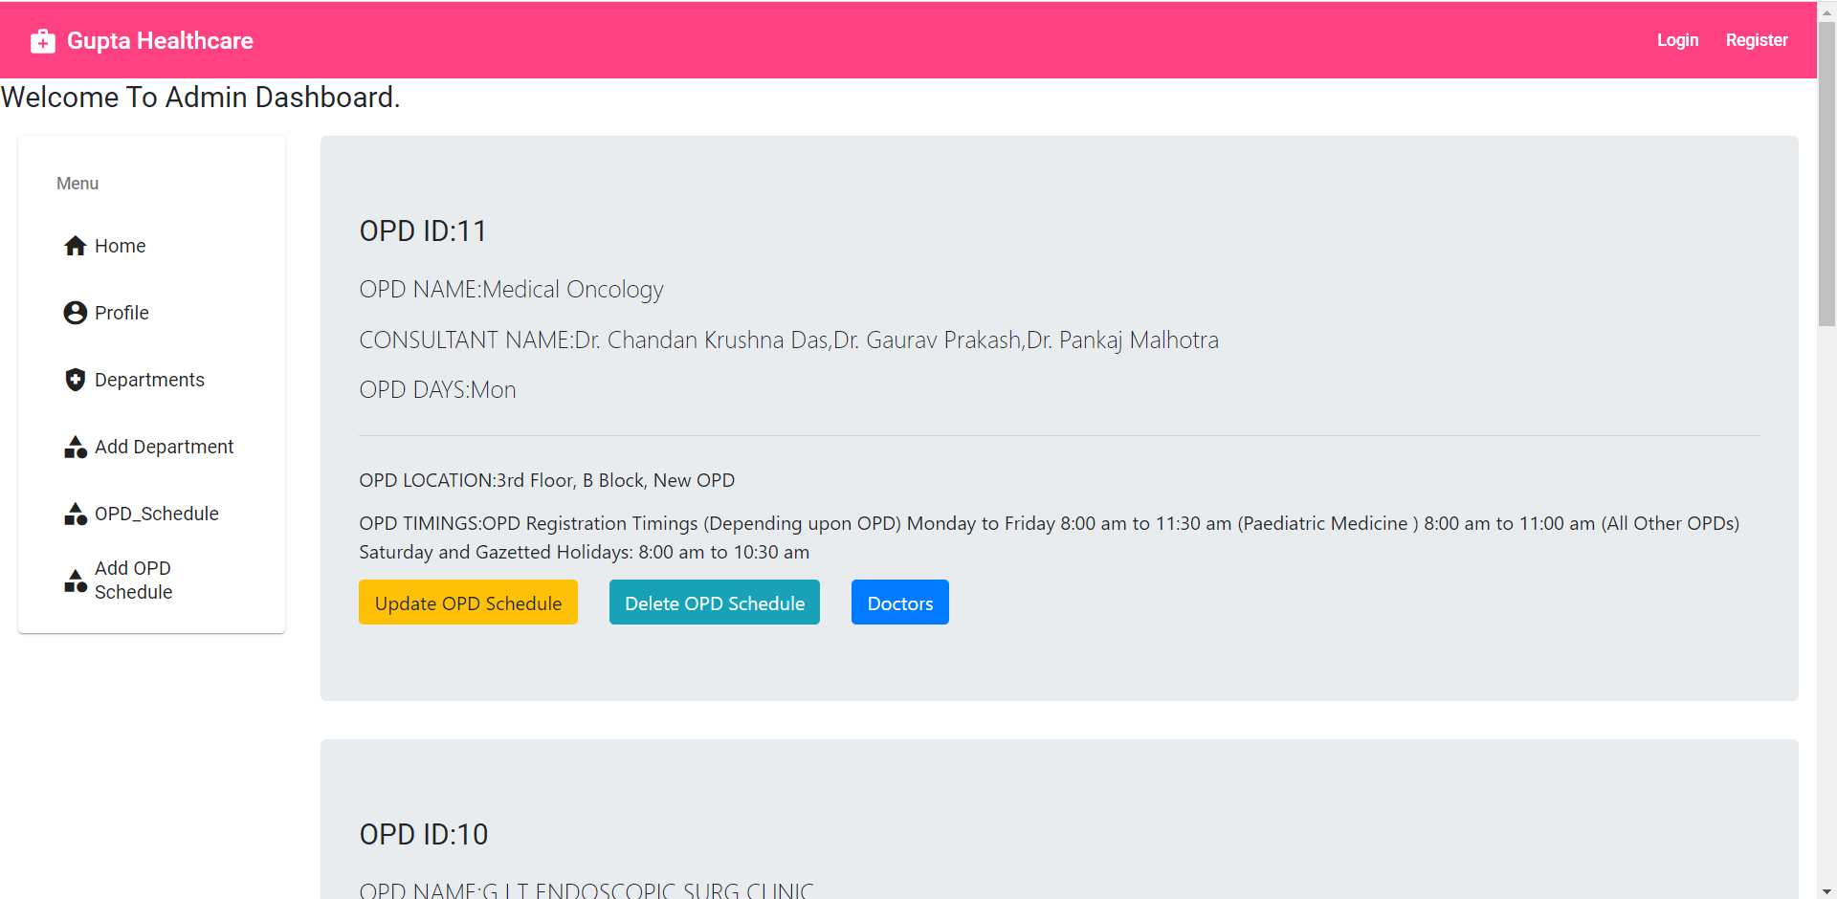
Screenshots of Project.
View OPD Schedule Screenshot.
Online Medical Management System.
May - 2022
10

Slide 11
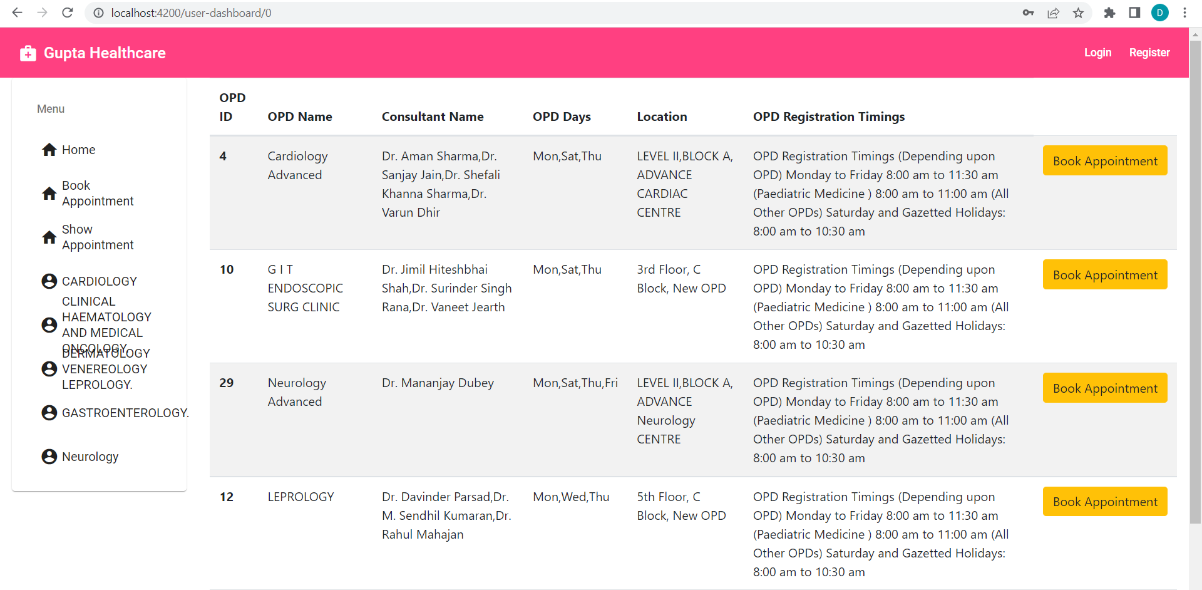
Screenshots Continued.
View OPD Schedule For Normal User Dashboard.
Online Medical Management System.
May - 2022
11

Slide 12
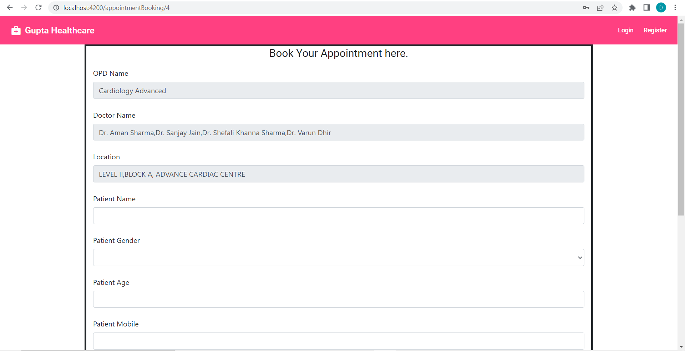
Screenshots Continued.
Appointment Booking.
Online Medical Management System.
May - 2022
12

Slide 13
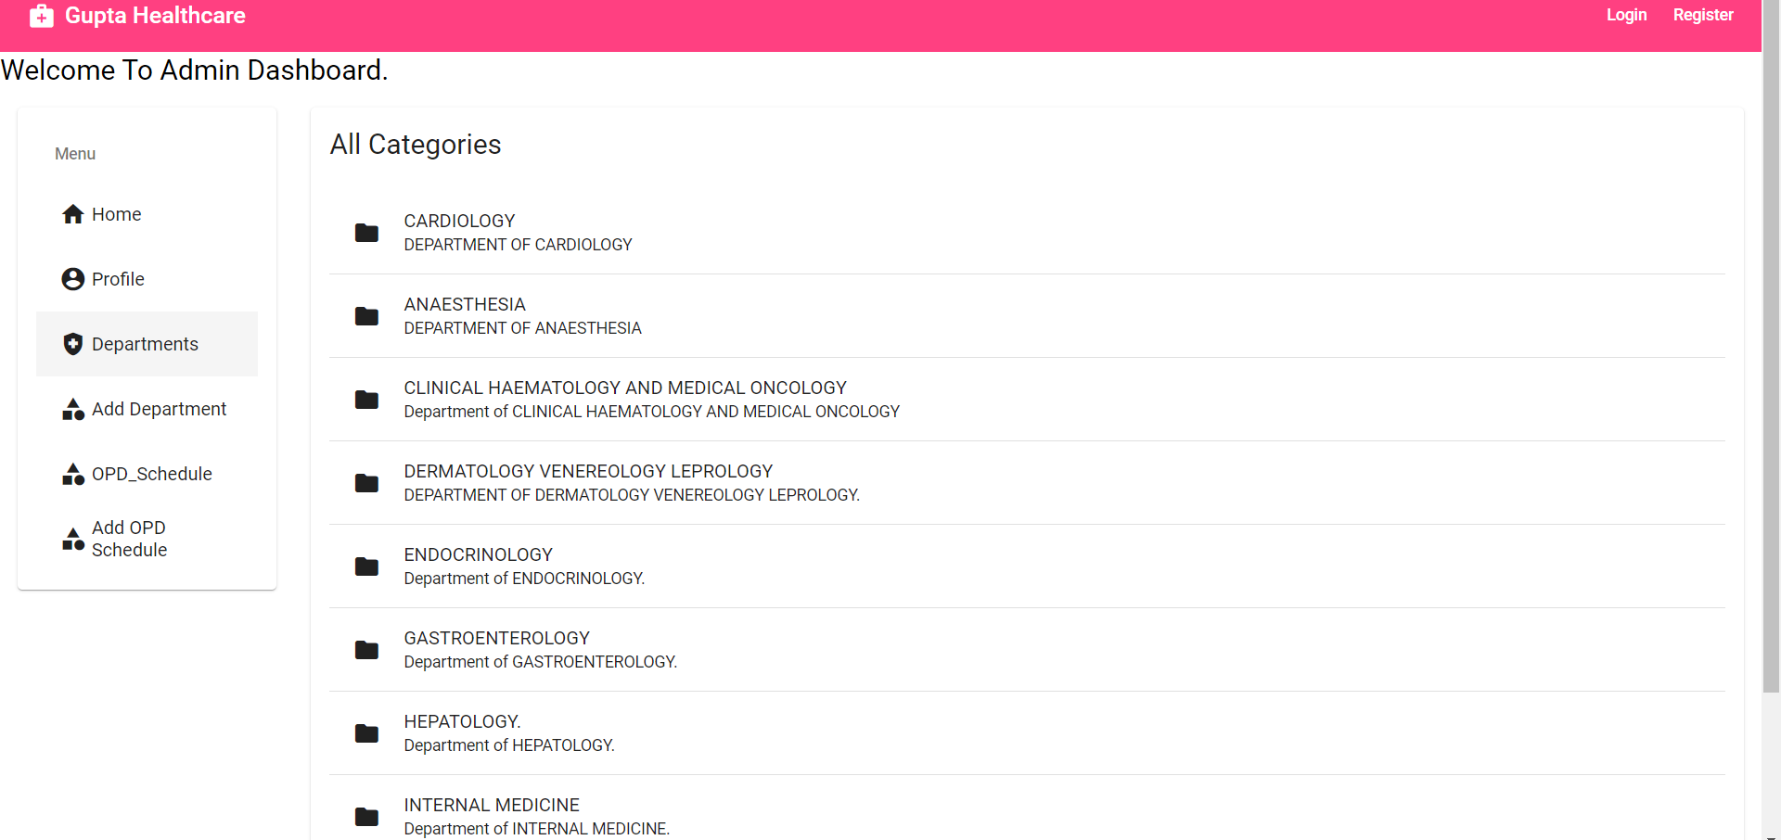
Screenshots Continued.
View Departments.
Online Medical Management System.
May - 2022
13

Slide 14
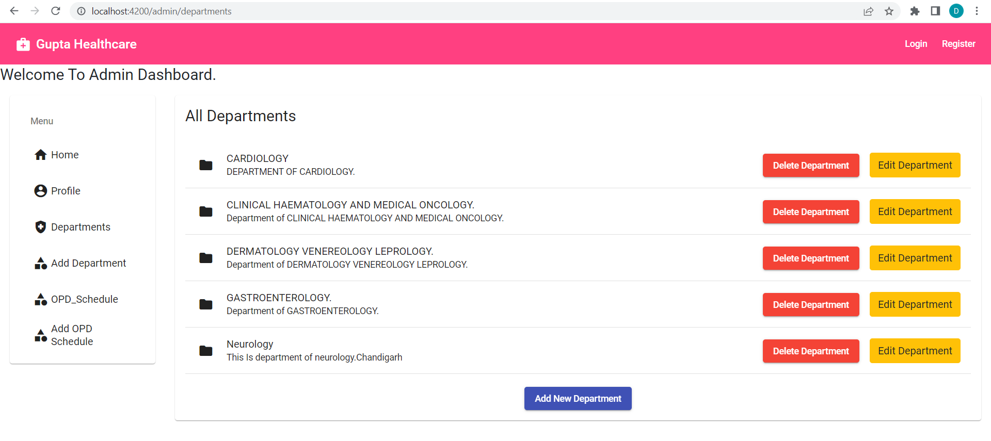
Screenshots Continued.
View Departments.
Online Medical Management System.
May - 2022
14

Slide 15
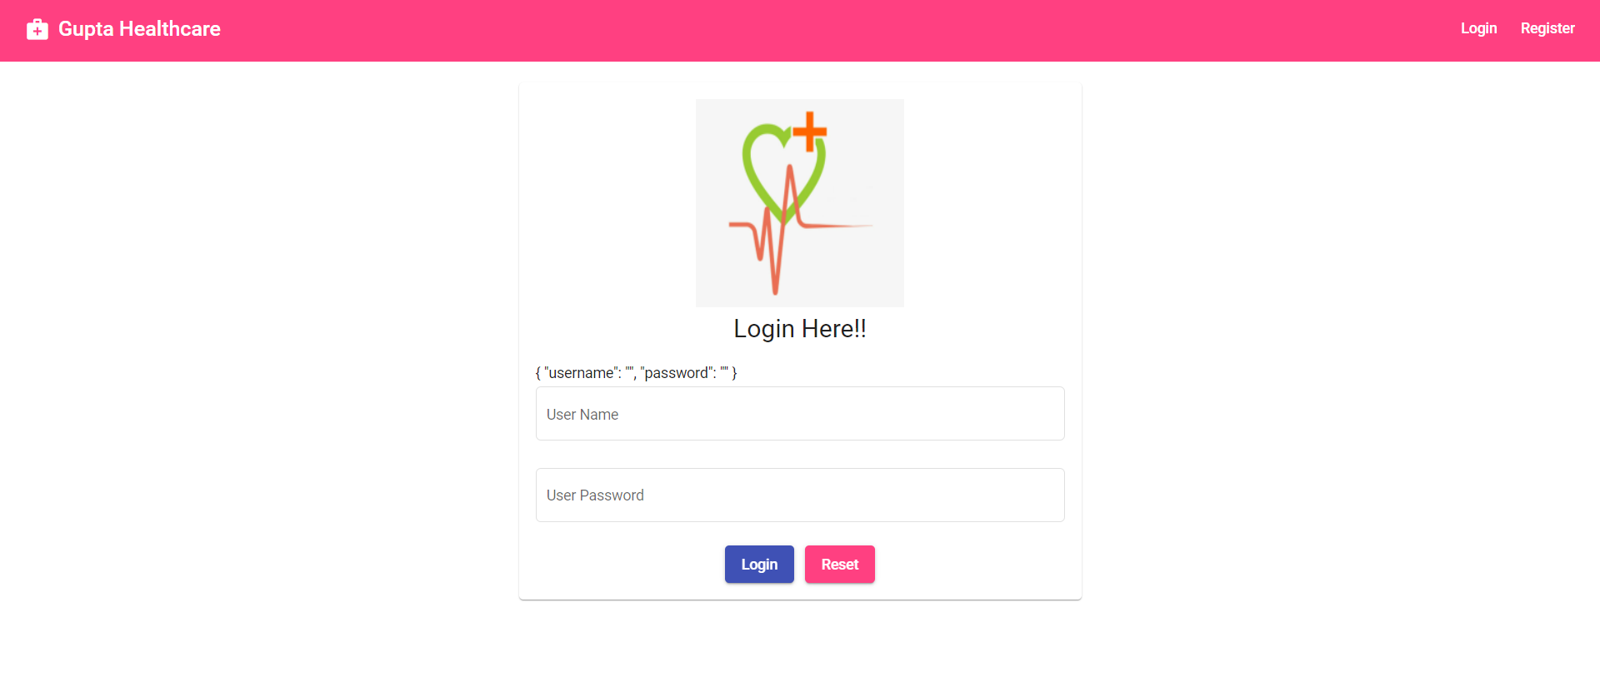
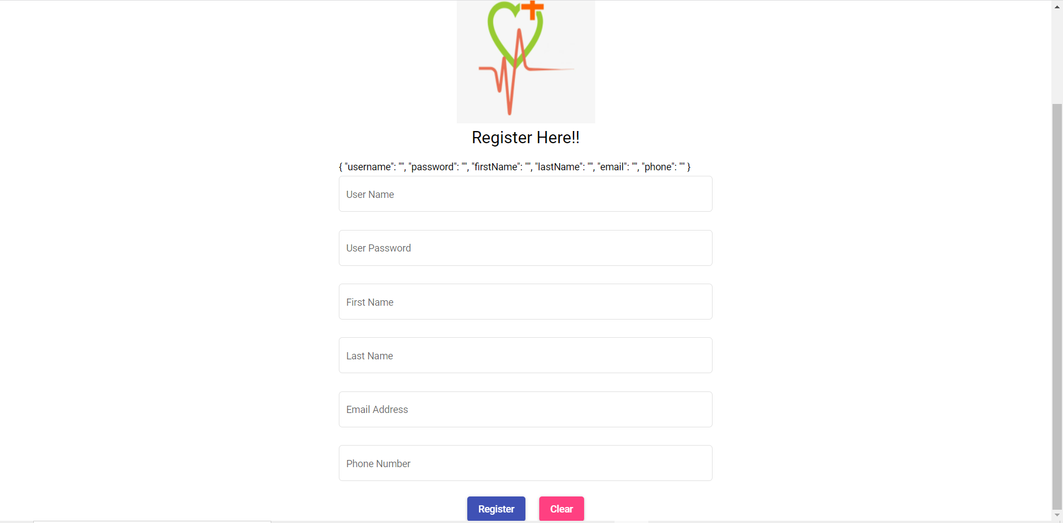
Screenshots Continued.
Login And Register.
Online Medical Management System.
May - 2022
15

Slide 16
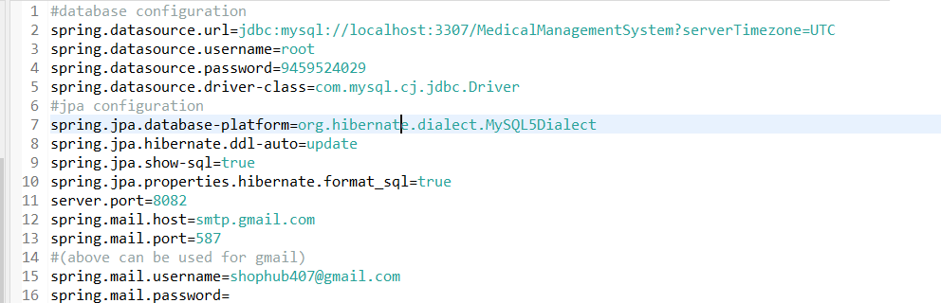
Application.properties configuration File.
In a spring boot application, application.properties file is used to write the application-related property into that file. This file contains the different configuration which is required to run the application in a different environment, and each environment will have a different property defined by it. Inside the application properties file, we define every type of property like changing the port, database connectivity, connection to the Tomcat server, and many more.
Online Medical Management System.
May - 2022
16

Slide 17
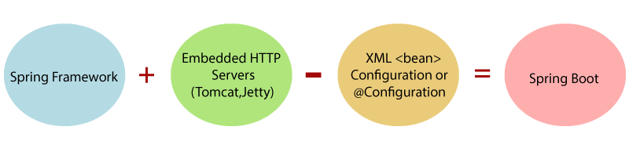
configuration.
7. Tools and technologies
Spring Boot is a project that is built on the top of the Spring Framework. It provides an easier and faster way to set up, configure, and run both simple and web-based applications.
It is a Spring module that provides the RAD (Rapid Application Development) feature to the Spring Framework. It is used to create a stand-alone Spring-based application that you can just run because it needs minimal Spring configuration.
Spring Boot(Backend)
Online Medical Management System.
May - 2022
17

Slide 18

Spring Boot Backend(Continued)
In short, Spring Boot is the combination of Spring Framework and Embedded Servers.
In Spring Boot, there is no requirement for XML configuration (deployment descriptor). It uses convention over configuration software design paradigm that means it decreases the effort of the developer.
We can use Spring STS IDE or Spring Initializr to develop Spring Boot Java applications.
Why should we use Spring Boot Framework?
We should use Spring Boot Framework because:
The dependency injection approach is used in Spring Boot.
It contains powerful database transaction management capabilities.
It simplifies integration with other Java frameworks like JPA/Hibernate ORM, Struts, etc.
It reduces the cost and development time of the application.
Spring Data: It simplifies data access from the relational and NoSQL databases.
Spring Security: It is a security framework that provides robust security to applications.
Online Medical Management System.
May - 2022
18

Slide 19
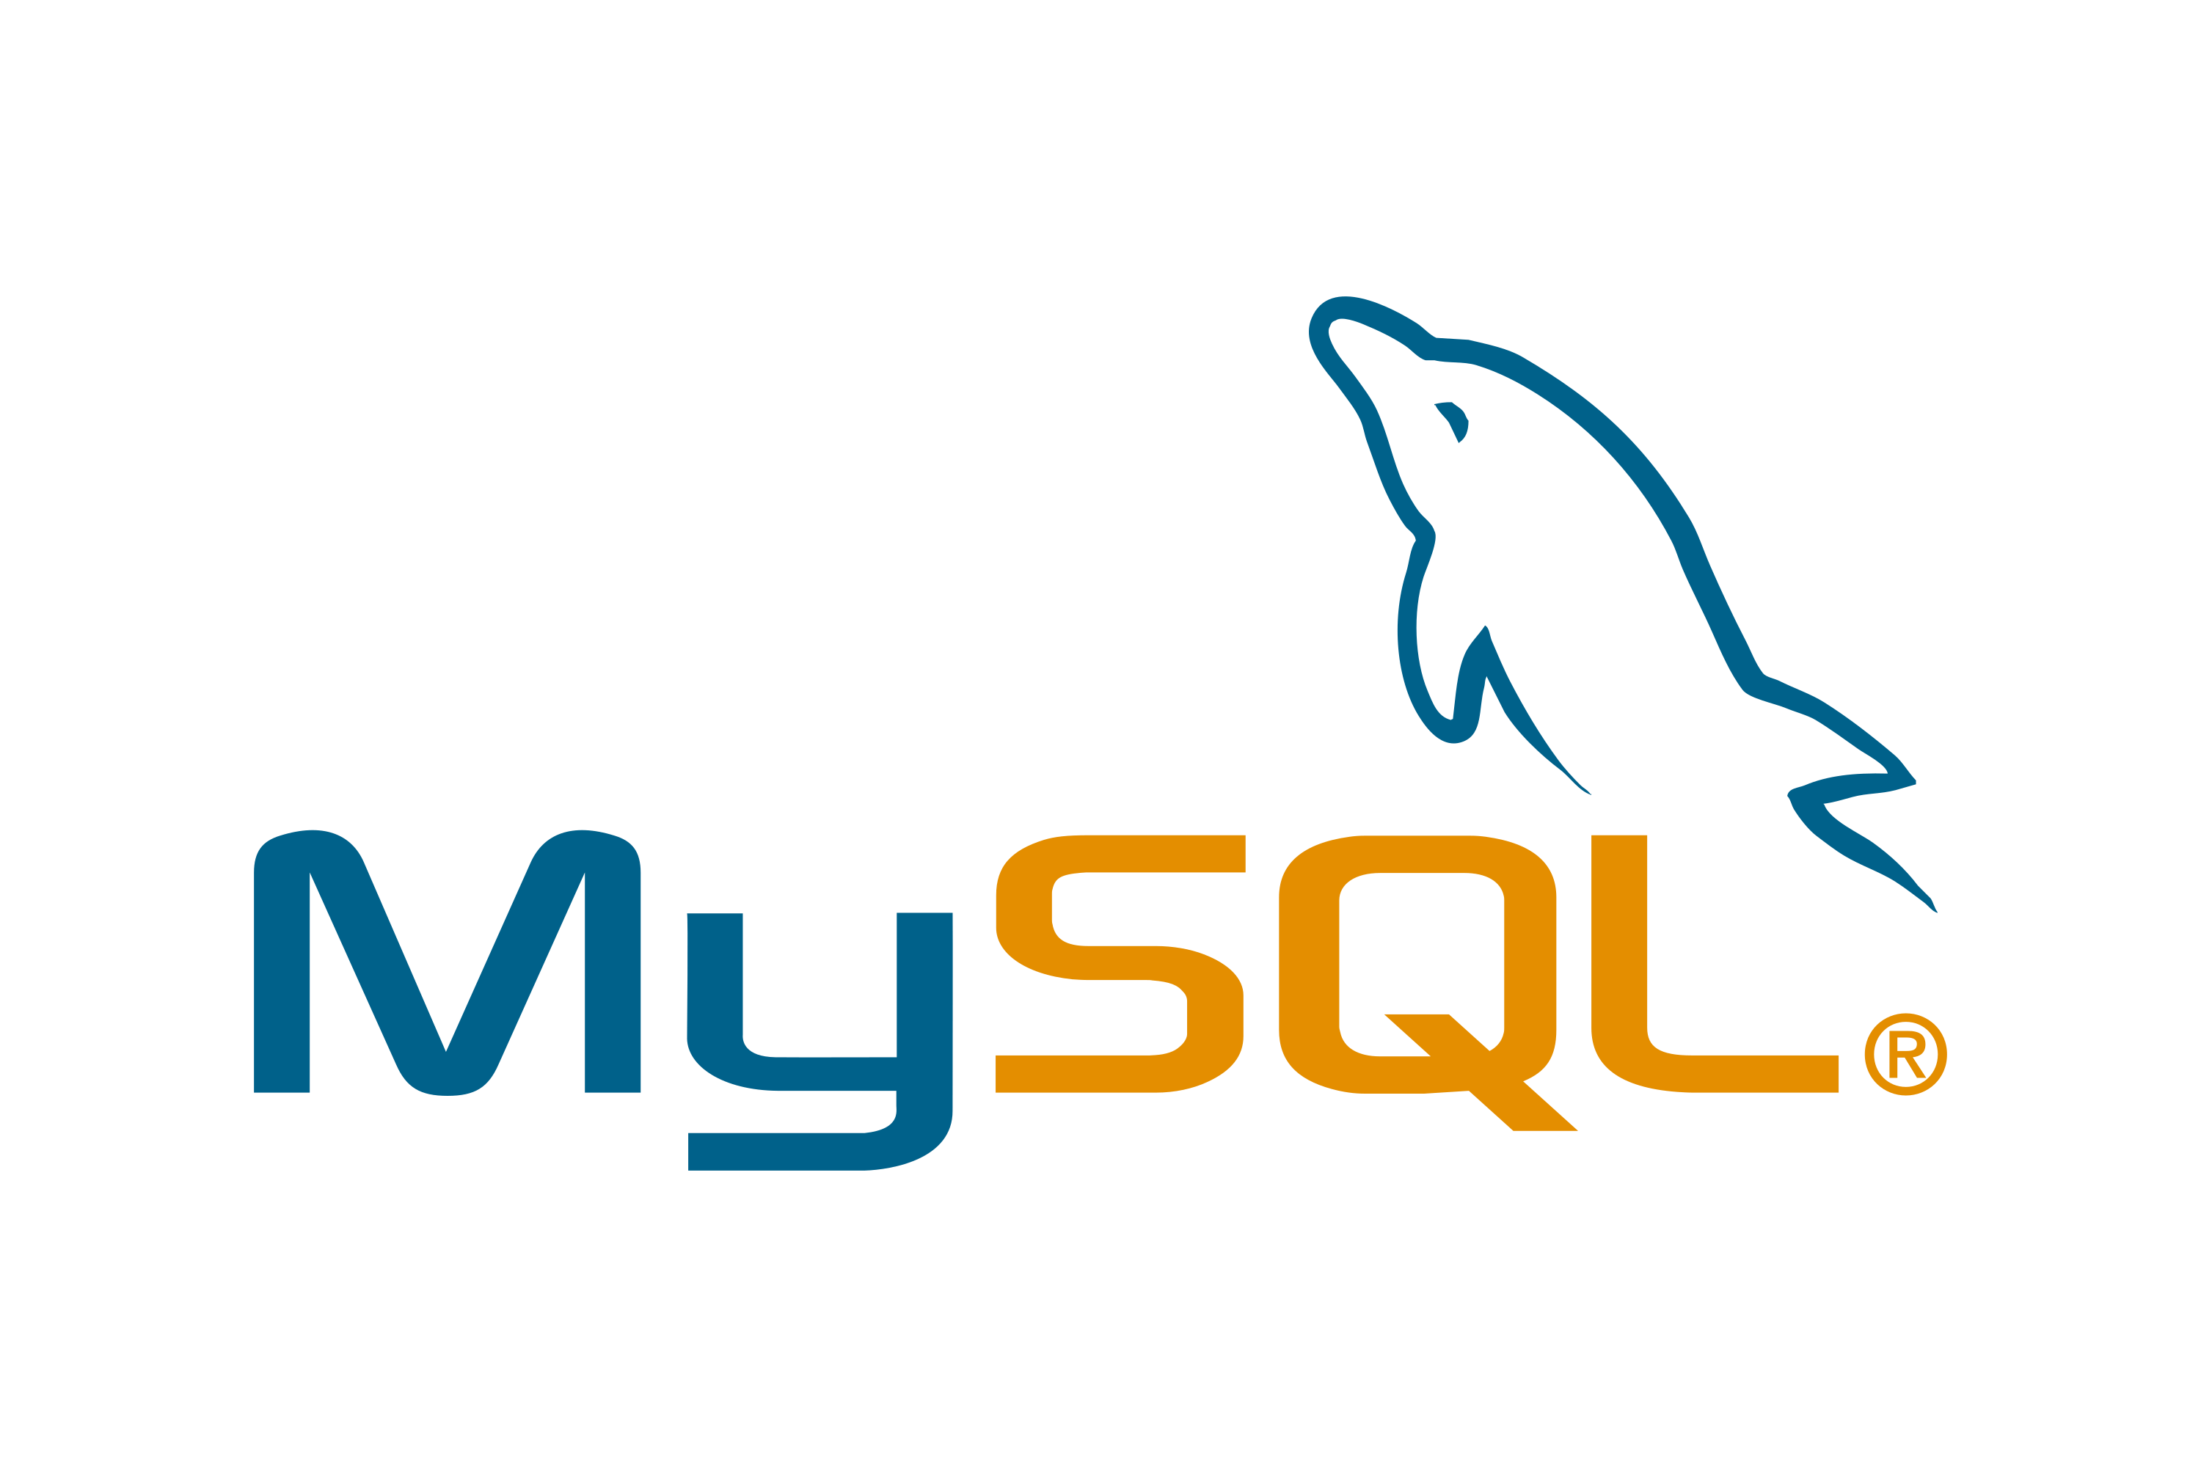
MYSQL Database.
MySQL is an open source relational database management system. For WordPress sites, that means it helps you store all your blog posts, users, plugin information, etc. It stores that information in separate “tables” and connects it with “keys”, which is why it's relational.
Online Medical Management System.
May - 2022
19

Slide 20
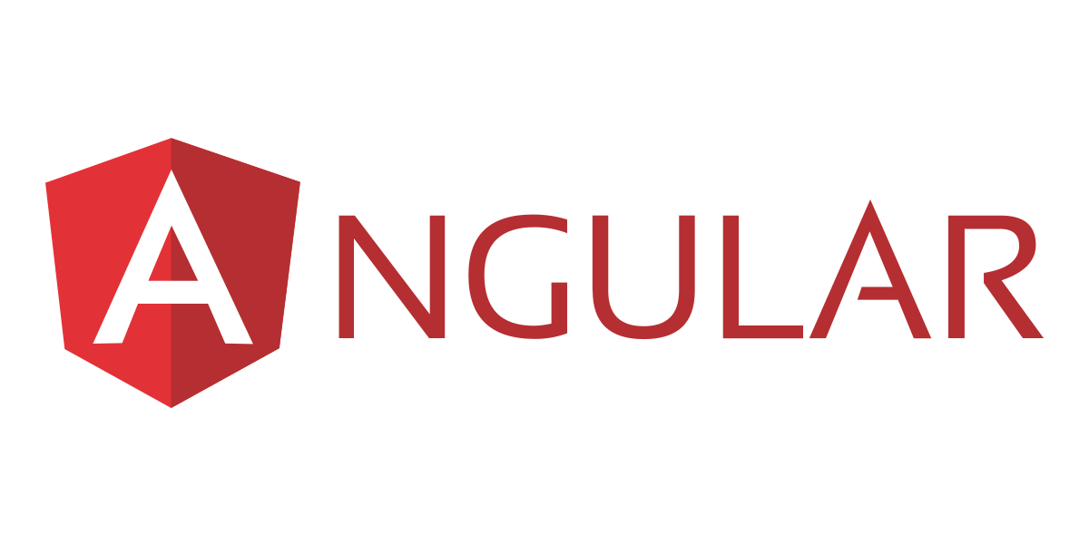
Angular(Frontend)
Angular is a platform and framework for building single-page client applications using HTML and TypeScript. Angular is written in TypeScript. It implements core and optional functionality as a set of TypeScript libraries that you import into your applications.
Components define views, which are sets of screen elements that Angular can choose among and modify according to your program logic and data
Components use services, which provide specific functionality not directly related to views. Service providers can be injected into components as dependencies, making your code modular, reusable, and efficient.
Online Medical Management System.
May - 2022
20

Slide 21
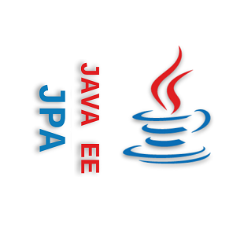
JAVA Persistence API
The Java Persistence API (JPA) is a specification of Java. It is used to persist data between Java object and relational database. JPA acts as a bridge between object-oriented domain models and relational database systems.
As JPA is just a specification, it doesn't perform any operation by itself. It requires an implementation. So, ORM tools like Hibernate, TopLink and iBatis implements JPA specifications for data persistence.
Online Medical Management System.
May - 2022
21

Slide 22

Hibernate
Hibernate is a java framework and ORM (Object Relation Mapping) tool that is used to provide the implementation of the JPA methods.
Hibernate is an ORM (Object Relational Mapper) tool that is used for interacting with different kinds of databases. For example if you want to connect to a certain database using plain old jdbc let's say oracle, then in that case you would have to write separate code for connecting to the database moreover you would have to also specify the database driver to use and also the database driver should be installed in your system. Spring framework takes care of such dependencies by using dependency injection. Hibernate is a framework that allows you to write code that is independent of the underlying database and by independent what I mean to say is that it doesn't matter whether you are running an Oracle database or a MySQL database
Online Medical Management System.
May - 2022
22

Slide 23
Spring Boot Technologies.
Spring Security
JWT Token
Tomcat Server
JPA
Hibernate
Mysql Driver(For connecting with database).
Online Medical Management System.
May - 2022
23

Slide 24
Angular Technologies.
Interceptor
Angular Material
HTML(Hyper Text Markup Language)
Bootstrap 5
MD5 Bootstrap
Flaticons
Google Font
CanActivate(Guard)
Routing
Online Medical Management System.
May- 2022
24

Slide 25
Conclusion.
My project is not still completed due to time constraint but I have implemented all the basic Create,Read,Update and Delete Functionalities and I will keep on adding new functionalities in this project in future as you know that the phase of development does not stop it continues endlessly.
Online Medical Management System.
May- 2022
25

Slide 26
Future Scope.
I will add payment gateway in this project after appointment confirmation.
I will add Mobile SMS service to send otp and appointment status to the patients.
I will also add doctor dashboard so that a particular doctor can approve or decline the appointment of the patient.
I will deploy this project on live server like Hostinger or GoDaddy.
I have also provided the github link for both repositories so that anyone can contribute.
Online Medical Management System.
May- 2022
26

Slide 27
References
Learn Code With Durgesh(Youtube Channel).
Error Resolving Source StackOverflow.
My Github Link For Frontend:https://github.com/AbhayGupta-cloud/MedicalManagementFrontend
My Github Link For Backend:https://github.com/AbhayGupta-cloud/MedicalManagementBackend
Online Medical Management System.
May - 2022
27

Slide 28


